Slide 1
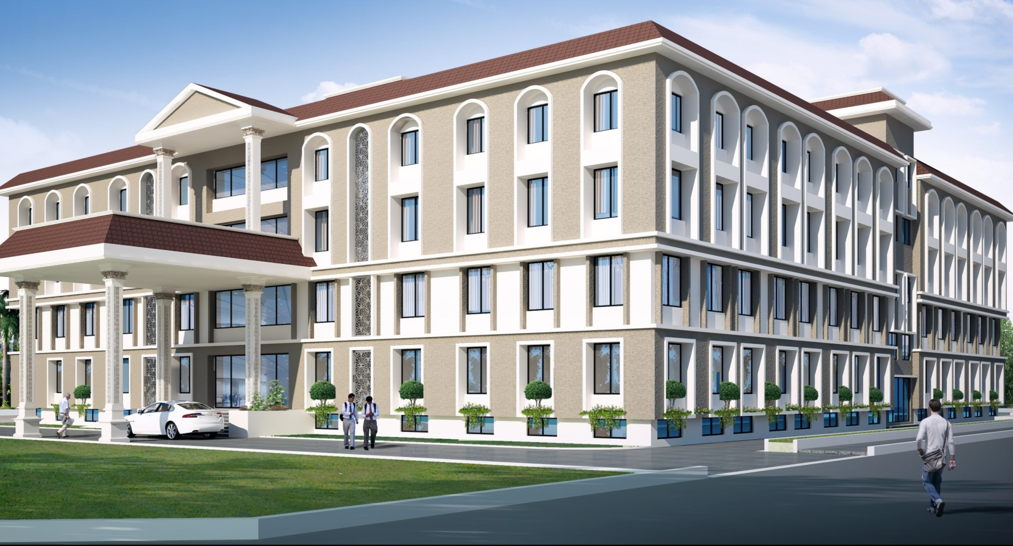

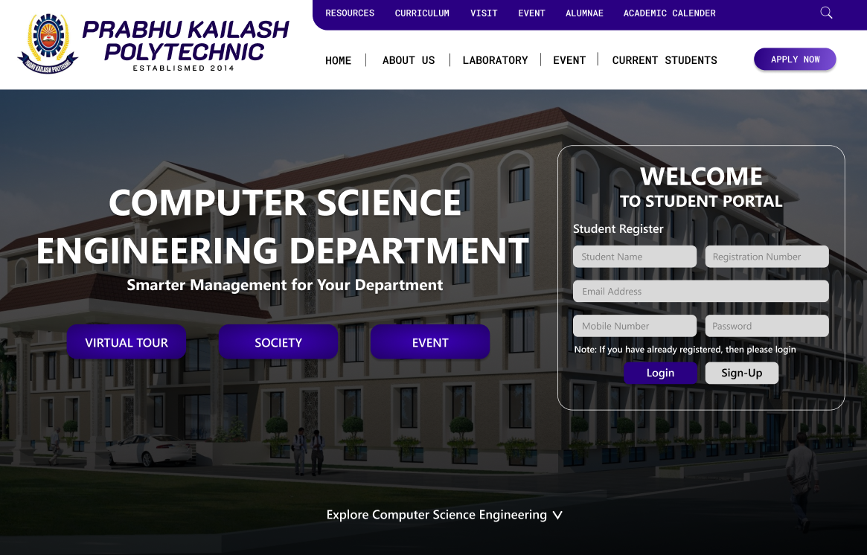
MAJOR PROJECT
INTRODUCTION
GROUP - A
The project aims to create a comprehensive and interactive website for the Computer Science Department at Prabhu Kailash Polytechnic
TOPIC - computer science engineering
Department website

Slide 2
MAJOR PROJECT
INTRODUCTION
OBJECTIVE AND GOALS
The project aims to create a comprehensive and interactive website for the Computer Science Department at Prabhu Kailash Polytechnic
Digitalize CSE Department
Provide easy access to information
• Academic Programs
• Faculty Profiles
• Student Project
• Department events
Enhance student experience
• Student Dashboard
• Online attendance system
• Access to academic resources
Community Collaboration
  • Student
  • Faculty
  • Alumni
GROUP - A
TOPIC - computer science engineering
Department website

Slide 3
INTRODUCTION
OBJECTIVE AND GOALS
The project aims to create a comprehensive and interactive website for the Computer Science Department at Prabhu Kailash Polytechnic
Digitalize CSE Department
Provide easy access to information
• Academic Programs
• Faculty Profiles
• Student Project
• Department events
Enhance student experience
• Student Dashboard
• Online attendance system
• Access to academic resources
Community Collaboration
  • Student
  • Faculty
  • Alumni

Slide 4
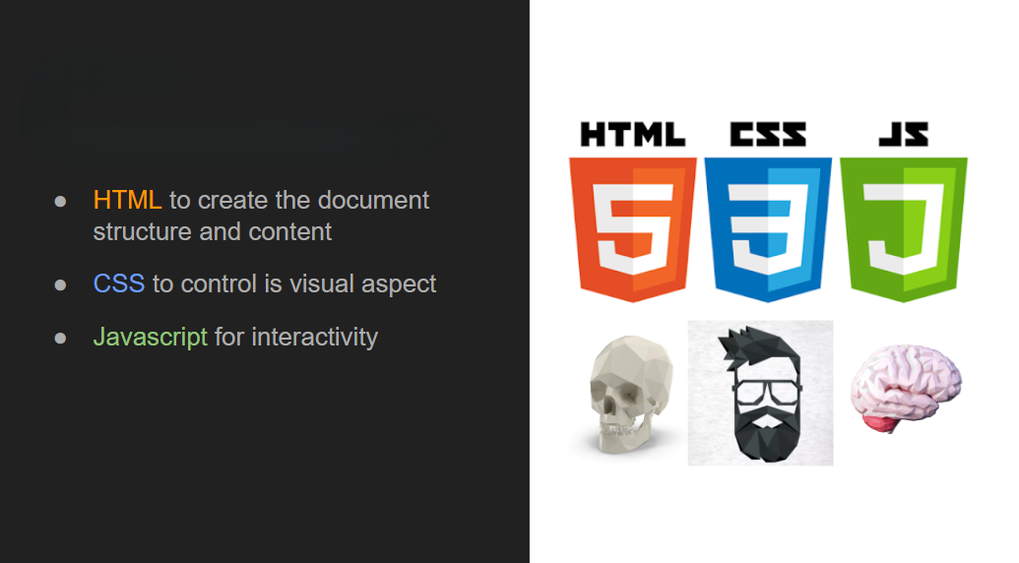
INTRODUCTION
OBJECTIVE AND GOALS
The project aims to create a comprehensive and interactive website for the Computer Science Department at Prabhu Kailash Polytechnic
Digitalize CSE Department
Provide easy access to information
• Academic Programs
• Faculty Profiles
• Student Project
• Department events
Enhance student experience
• Student Dashboard
• Online attendance system
• Access to academic resources
Community Collaboration
  • Student
  • Faculty
  • Alumni
WHICH TECHNOLOGY WE ARE USED

Slide 5
WHICH TECHNOLOGY WE ARE USED
FEATURES

Slide 6
WHICH TECHNOLOGY WE ARE USED
TextBox 1
FEATURES
Home Page Features
Overview: The homepage as the entry point to the website, providing visitors with an introduction to the Computer Science Department

Slide 7
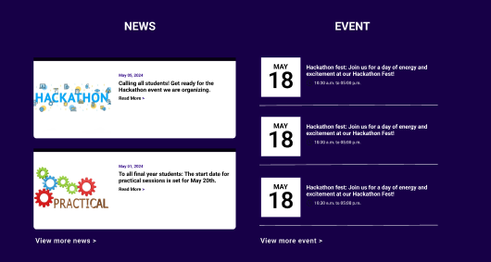
TextBox 1
FEATURES
Home Page Features
Overview: The homepage as the entry point to the website, providing visitors with an introduction to the Computer Science Department
News and Announcements
Upcoming Events
Featured Content

Slide 8
TextBox 1
FEATURES
Home Page Features
Overview: The homepage as the entry point to the website, providing visitors with an introduction to the Computer Science Department
News and Announcements
Upcoming Events
Featured Content

Slide 9
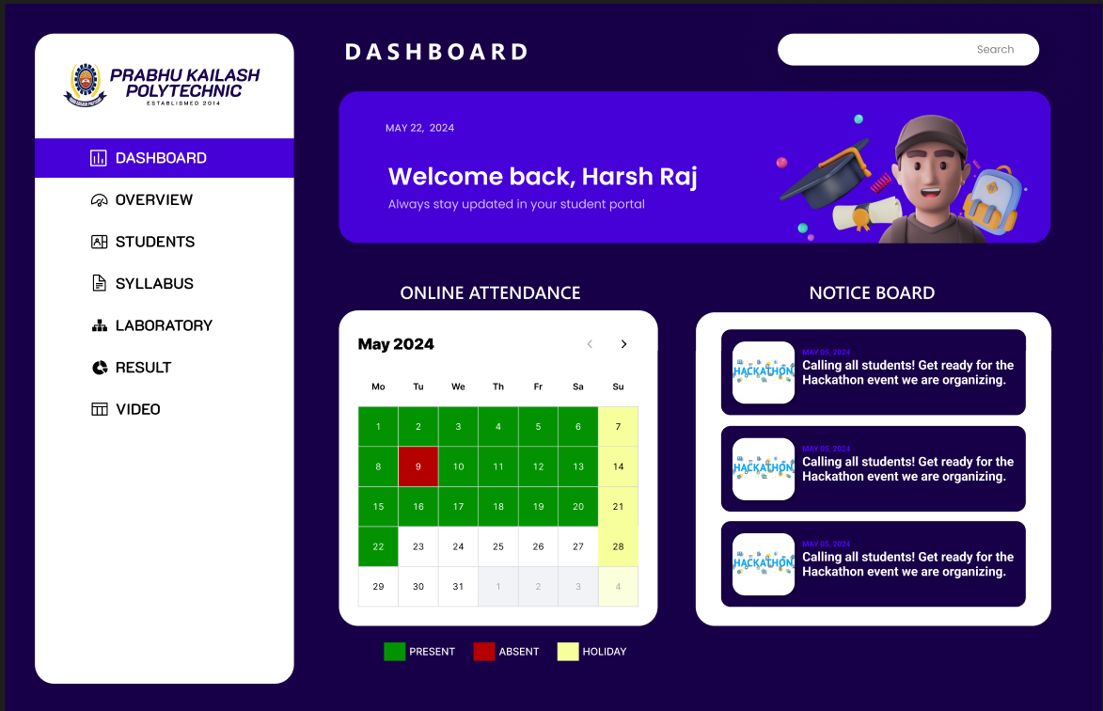
TextBox 1
FEATURES
Student Dashboard
Home Page Features
Overview: The homepage as the entry point to the website, providing visitors with an introduction to the Computer Science Department
Overview: The student dashboard provides a personalized portal for students to access important information, resources.
Class Schedule
Grades and Assignments
Announcements and Notification
Academic Resources
News and Announcements
Upcoming Events
Featured Content

Slide 10
TextBox 1
FEATURES
Student Dashboard
Home Page Features
Overview: The homepage as the entry point to the website, providing visitors with an introduction to the Computer Science Department
Overview: The student dashboard provides a personalized portal for students to access important information, resources.
Class Schedule
Grades and Assignments
Announcements and Notification
Academic Resources
News and Announcements
Upcoming Events
Featured Content

Slide 11
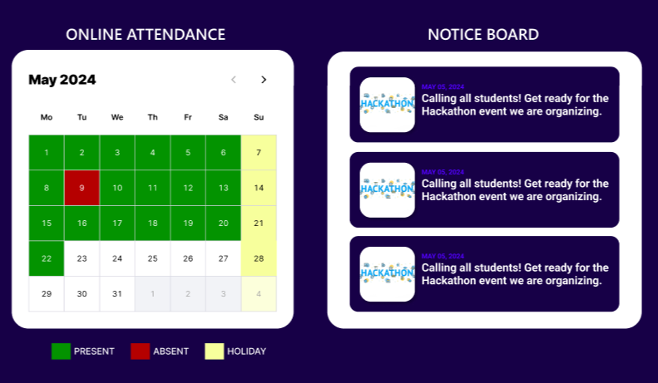
TextBox 1
FEATURES
Student Dashboard
Online Attendance System
Overview: An integrated online attendance system allows students to mark their attendance and view their attendance records conveniently
Mark Attendance
Attendance Records
Notification
Overview: The student dashboard provides a personalized portal for students to access important information, resources.
Class Schedule
Grades and Assignments
Announcements and Notification
Academic Resources

Slide 12
TextBox 1
FEATURES
Online Attendance System
Overview: An integrated online attendance system allows students to mark their attendance and view their attendance records conveniently
Mark Attendance
Attendance Records
Notification

Slide 13
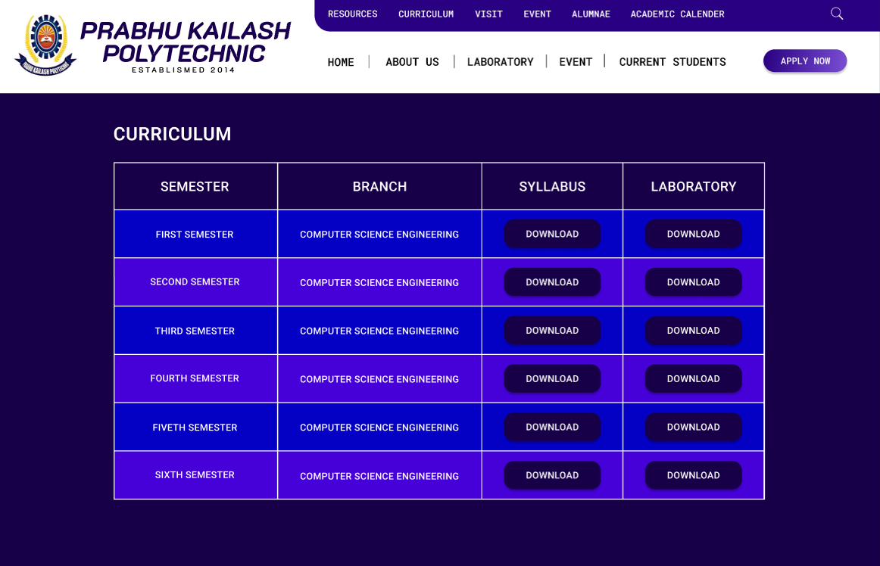
TextBox 1
FEATURES
Course Materials Repository​
Online Attendance System
Overview: The course materials repository serves as a centralized hub for course related resources, including lecture notes, slides, assignments, and study materials.​
Course Listings​
Lecture Notes​
Assignments and Exams​
Supplementary Resources
Overview: An integrated online attendance system allows students to mark their attendance and view their attendance records conveniently
Mark Attendance
Attendance Records
Notification

Slide 14
TextBox 1
FEATURES
Course Materials Repository​
Overview: The course materials repository serves as a centralized hub for course related resources, including lecture notes, slides, assignments, and study materials.​
Course Listings​
Lecture Notes​
Assignments and Exams​
Supplementary Resources
FUTURE ENHANCEMENTS

Slide 15
TextBox 1
FEATURES
Course Materials Repository​
Overview: The course materials repository serves as a centralized hub for course related resources, including lecture notes, slides, assignments, and study materials.​
Course Listings​
Lecture Notes​
Assignments and Exams​
Supplementary Resources
FUTURE ENHANCEMENTS
AI-Powered Chatbot
AI-powered chatbot to provide instant assistance and support to users navigating the website.
The chatbot can answer frequently asked questions.

Slide 16
FUTURE ENHANCEMENTS
AI-Powered Chatbot
Virtual Campus Tours
AI-powered chatbot to provide instant assistance and support to users navigating the website.
The chatbot can answer frequently asked questions.
Enhancing the website with immersive virtual campus tours using 360-degree photography or virtual reality (VR) technology.
Prospective students and visitors can explore campus facilities, classrooms, residence halls, and recreational areas from the comfort of their homes.

Slide 17
FUTURE ENHANCEMENTS
AI-Powered Chatbot
Virtual Campus Tours
Alumni Career Services Platform
AI-powered chatbot to provide instant assistance and support to users navigating the website.
The chatbot can answer frequently asked questions.
Enhancing the website with immersive virtual campus tours using 360-degree photography or virtual reality (VR) technology.
Prospective students and visitors can explore campus facilities, classrooms, residence halls, and recreational areas from the comfort of their homes.
Expanding the alumni section of the website to include a comprehensive career services platform, offering job search tools, networking opportunities, mentorship programs, and professional development.
Alumni can access exclusive job listings, career webinars, and industry insights to support their ongoing career growth.

Slide 18
FUTURE ENHANCEMENTS
Virtual Campus Tours
Alumni Career Services Platform
Social Learning Communities
Enhancing the website with immersive virtual campus tours using 360-degree photography or virtual reality (VR) technology.
Prospective students and visitors can explore campus facilities, classrooms, residence halls, and recreational areas from the comfort of their homes.
Expanding the alumni section of the website to include a comprehensive career services platform, offering job search tools, networking opportunities, mentorship programs, and professional development.
Alumni can access exclusive job listings, career webinars, and industry insights to support their ongoing career growth.
Facilitating social learning communities and discussion forums within the website, where students, faculty, and alumni can engage in collaborative learning, knowledge sharing, and academic discourse.
Special interest groups, study circles, and professional networking communities can foster a culture of lifelong learning and community involvement.

Slide 19
FUTURE ENHANCEMENTS
Alumni Career Services Platform
Social Learning Communities
Ongoing Maintenance and Updates
Expanding the alumni section of the website to include a comprehensive career services platform, offering job search tools, networking opportunities, mentorship programs, and professional development.
Alumni can access exclusive job listings, career webinars, and industry insights to support their ongoing career growth.
Facilitating social learning communities and discussion forums within the website, where students, faculty, and alumni can engage in collaborative learning, knowledge sharing, and academic discourse.
Special interest groups, study circles, and professional networking communities can foster a culture of lifelong learning and community involvement.
Committing to ongoing maintenance, security updates, and content refreshes to keep the website relevant, secure, and up-to-date with the latest industry trends and technological advancements.
Regular user feedback surveys and usability testing can provide valuable input for iterative improvements and feature enhancements.

Slide 20
Committing to ongoing maintenance, security updates, and content refreshes to keep the website relevant, secure, and up-to-date with the latest industry trends and technological advancements. Regular user feedback surveys and usability testing can provide valuable input for iterative improvements and feature enhancements.
THANK YOU
THANK YOU ​
FUTURE ENHANCEMENTS
Social Learning Communities
Ongoing Maintenance and Updates
Facilitating social learning communities and discussion forums within the website, where students, faculty, and alumni can engage in collaborative learning, knowledge sharing, and academic discourse.
Special interest groups, study circles, and professional networking communities can foster a culture of lifelong learning and community involvement.
Committing to ongoing maintenance, security updates, and content refreshes to keep the website relevant, secure, and up-to-date with the latest industry trends and technological advancements.
Regular user feedback surveys and usability testing can provide valuable input for iterative improvements and feature enhancements.
HARSH RAJ (L) - 611921821004
AMIT KUMAR - 611921821002
KHUSHI KUMARI - 611921821001

Slide 21
FUTURE ENHANCEMENTS
THANK YOU ​
Committing to ongoing maintenance, security updates, and content refreshes to keep the website relevant, secure, and up-to-date with the latest industry trends and technological advancements. Regular user feedback surveys and usability testing can provide valuable input for iterative improvements and feature enhancements.
THANK YOU
HARSH RAJ (L) - 611921821004
AMIT KUMAR - 611921821002
KHUSHI KUMARI - 611921821001
Ongoing Maintenance and Updates
Committing to ongoing maintenance, security updates, and content refreshes to keep the website relevant, secure, and up-to-date with the latest industry trends and technological advancements.
Regular user feedback surveys and usability testing can provide valuable input for iterative improvements and feature enhancements.

